Slide 1
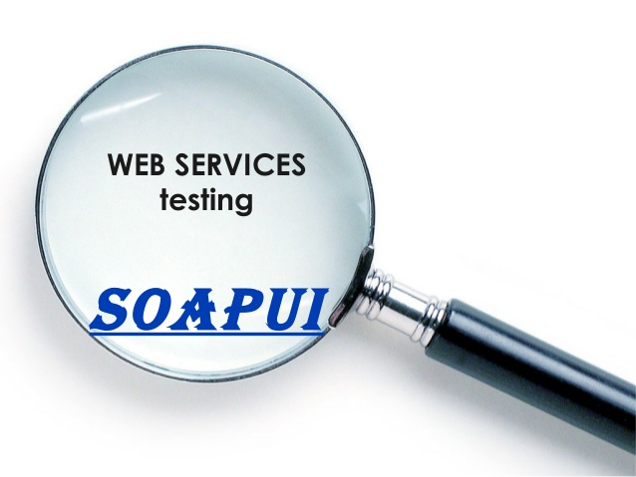
Web Services Testing
By
Vijay Kadaikar

Slide 2
Agenda
Web Service introduction
SOA Concepts
SOAP & REST Overview
SOAP UI Introduction
Tool explanation
Project creation in SOAP UI
Creating test suite and test cases
Types of test steps
Assertions and their types
Properties and their types
Test execution
Reporting
Groovy Basics

Slide 3
Web Service introduction
Web services are software components that communicate irrespective of underlying technology.
It uses a collection of open protocols and standards used for exchanging data between applications or systems.
To summarize, a complete web service is, therefore, any service that:
Is available over the Internet or private (intranet) networks
Uses a standardized messaging system (XML, JSON,HTML etc.,)
Is not tied to any one operating system or programming language
Is self-describing via a common grammar
Is discoverable via a simple find mechanism

Slide 4
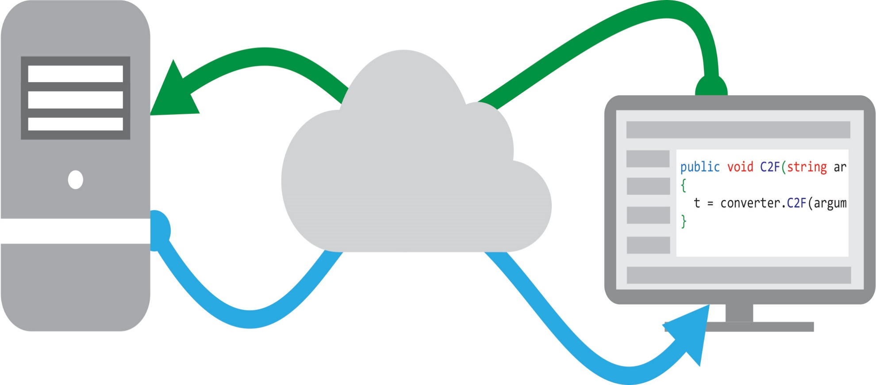
Web Service Structure

Slide 5
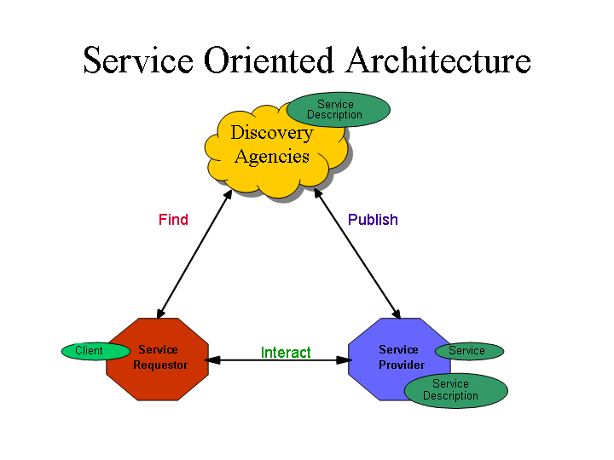
Web Services Basics (contd.)
Common interpreters HTML & XML is the basis for web services.
Inter operability
Multiple consumer handling
Services over the net
Platform independent
Code -re usability
Security

Slide 6
Acronyms
XML - Extensible Markup Language
WSDL - Web Service Definition Language
SOAP - Simple Object Access Protocol
UDDI - Universal Description Discovery and Integration
REST - Representational State Transfer
WADL - Web Application Description Language
CRUD- Create Retrieve Update Delete
PGPD- Post Get Put Delete

Slide 7
Web Services Basics (contd.)
Following are the basic standards for the web services :
XML – It is the core language which is being used in web services and XML Schema are used to define the elements used in Web Services communication.
WSDL – It is the interface developed with XML which has complete definition of the respective web service in the form of port type, port, Types, Binding and service.
SOAP– It is a protocol which is being used in data transfer of the web service. SOAP messages are XML documents that contains the elements like envelope , Header , Body etc..
UDDI – (Universal Description Discovery and Integration) it is described as the repository of Web services, UDDI is a specification for creating an XML-based registry that lists information about businesses and the Web services they offer

Slide 8
SOA Basics
An architecture or design pattern used to interact with a software component with another component by using protocol over network
It’s a language independent
It’s a platform independent
It’s an application independent
A2A (application to application)
EAI (Enterprise application integration)

Slide 9
SOA Basics (contd.)
Main components in SOA:
Services provider
Service requestor
Service Brooker
Main Actions in SOA:
Publish
Binding
Locating / Finding

Slide 10
SOAP & REST Overview
There are many web service types and following two are widely being used in the current market trend
SOAP (Simple object access protocol) Service
It allows only XML data format and uses WSDL
Standardized specifications and suits for enterprise applications
Language, platform, and transport independent
Build in error handling and security specs
REST (Representation state transfer) Service
Different data formats can be used and it uses WADL
Light weight and less complex for maintenance
It follows the stateless model and uses HTTP/HTTPS for transfer
Uses HTTP standard methods like (GET, PUT, POST, DELETE)

Slide 11
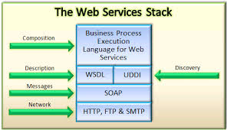
Protocol stack

Slide 12
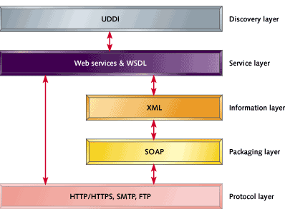
Service Layers

Slide 13
Sample SOAP Request
<soapenv:Envelope xmlns:soapenv="http://schemas.xmlsoap.org/soap/envelope/" xmlns:xsd="http://www.w3.org/2001/XMLSchema" xmlns:xsi="http://www.w3.org/2001/XMLSchema-instance"> <soapenv:Header> <ns1:RequestHeader soapenv:actor="http://schemas.xmlsoap.org/soap/actor/next" soapenv:mustUnderstand="0" xmlns:ns1="https://www.google.com/apis/ads/publisher/v201508"> <ns1:networkCode>123456</ns1:networkCode> <ns1:applicationName>DfpApi-Java-2.1.0-dfp_test</ns1:applicationName> </ns1:RequestHeader> </soapenv:Header> <soapenv:Body> <getAdUnitsByStatement xmlns="https://www.google.com/apis/ads/publisher/v201508"> <filterStatement> <query>WHERE parentId IS NULL LIMIT 500</query> </filterStatement> </getAdUnitsByStatement> </soapenv:Body> </soapenv:Envelope>

Slide 14
Sample SOAP Response
<soap:Envelope xmlns:soap="http://schemas.xmlsoap.org/soap/envelope/"> <soap:Header> <ResponseHeader xmlns="https://www.google.com/apis/ads/publisher/v201508"> <requestId>xxxxxxxxxxxxxxxxxxxx</requestId> <responseTime>1063</responseTime> </ResponseHeader> </soap:Header> <soap:Body> <getAdUnitsByStatementResponse xmlns="https://www.google.com/apis/ads/publisher/v201508"> <rval> <totalResultSetSize>1</totalResultSetSize> <startIndex>0</startIndex> <results> <id>2372</id> <name>RootAdUnit</name> <description></description> <targetWindow>TOP</targetWindow> <status>ACTIVE</status> <adUnitCode>1002372</adUnitCode> <inheritedAdSenseSettings> <value> </value> </inheritedAdSenseSettings> </results> </rval> </getAdUnitsByStatementResponse> </soap:Body> </soap:Envelope>

Slide 15
Sample Rest Request
POST http://bzwbcqa83.hwi.local:80/api/token
HTTP/1.1 Accept-Encoding: gzip,deflate
Content-Type: application/x-www-form-urlencoded
Content-Length: 52
Host: bzwbcqa83.hwi.local:80
Connection: Keep-Alive
User-Agent: Apache-HttpClient/4.1.1 (java 1.5)
grant_type=password&username=vijay&password=Test@456

Slide 16
Sample Rest Response
HTTP/1.1 200 OK
Cache-Control: no-cache
Pragma: no-cache
Content-Type: application/json; charset=utf-8
Date: Tue, 19 Jan 2016 10:13:20 GMT
Content-Length: 2276
{
"id": 51,
"mobilePushServiceId": 2,
"pushNotificationId": "NIRPushNotf6",
"pushNotificationEnabled": true,
"deviceName": "NIRDevice1",
"permanentDeviceId": "PermDev1",
"isActive": false
}

Slide 17
Few HTTP status codes
Following are the few HTTP status codes that come in REST response :
200 OK - Standard response for successful HTTP requests.
The response will contain an entity corresponding to the requested resource
201 Created - Standard response for successful HTTP Post requests.
The request has been fulfilled and resulted in a new resource being created.
304 Not Modified - Standard response for negative HTTP Put requests.
This means that there is no need to retransmit the resource, since the client still has a previously-downloaded copy

Slide 18
Few HTTP status codes (contd.)
400 Bad Request
The server cannot or will not process the request due to ( malformed request syntax, invalid request message framing)
401 Unauthorized
Similar to 403 Forbidden, but specifically for use when authentication is required and has failed or has not yet been provided.
405 Method Not Allowed
A request was made of a resource using a request method not supported by that resource
404 Not Found
The requested resource could not be found but may be available again in the future
415 Unsupported Media Type
The request entity has a media type which the server or resource does not support.
403 Forbidden
The request was a valid request, but the server is refusing to respond to it.

Slide 19
Few HTTP status codes (contd.)
500 Internal Server Error
A generic error message, given when an unexpected condition was encountered and no more specific message is suitable.
503 Service Unavailable
The server is currently unavailable (because it is overloaded or down for maintenance). Generally, this is a temporary state
502 Bad Gateway
The server was acting as a gateway or proxy and received an invalid response from the upstream server
504 Gateway Timeout
The server was acting as a gateway or proxy and did not receive a timely response from the upstream server
526 Invalid SSL Certificate
CloudFlare could not validate the SSL/TLS certificate that the origin server presented.

Slide 20


Slide 21

Web Services Testing
Day 2

Slide 22




SOAP UI Introduction

Slide 23
SOAP UI Introduction (contd.)
Introduction
SOAP UI is a tool for Testing the Web Services by providing the client structure to communicate with server.
SOAP UI supports for various kind of protocols like SOAP or HTTP etc...
We have both Open Source version and professional Version
Open Source is Free
Pro is licensed
Pro has all build in features available like Advanced Reporting, generating graphs, Data Collection, Scripting Libraries, Test Debugging etc..

Slide 24
SOAP UI Introduction (contd.)
When to start SOAP UI testing
Web Service developing completed and UI development is in progress, we can go for web service testing.
Few web service that runs in backend like alert generation, batch registration , batch payments etc can be tested using SOAP UI.

Slide 25
SOAP UI vs SOAP UI PRO
Support features | SoapUI | SoapUI NG Pro
Community | Y | Y
E-mail Support |  | Y
Forum Support |  | Y
Nightly Builds |  | Y
Maintenance |  | Y
Support Issue Priority |  | Y

Slide 26
SOAP UI vs SOAP UI PRO
General features | SoapUI | SoapUI NG Pro
Standalone Application | Y | Y
IDE Plugins | Y
Tabbed Desktop |  | Y
Groovy Code Templates |  | Y
Workspace Management | Y | Y
Multi Environment Support |  | Y
Floating Licenses |  | Y

Slide 27
SOAP UI vs SOAP UI PRO
Technology Support | SoapUI | SoapUI NG Pro
SOAP/WSDL | Y | Y
REST | Y | Y
JMS | Y | Y
AMF | Y | Y
JDBC | Y | Y
HTTP | Y | Y
MQTT (MQ Telemetry Transport) | Y | Y
CoAP (constraint Application Protocol) | Y | Y

Slide 28
SOAP UI vs SOAP UI PRO
Functional Testing features | SoapUI | SoapUI NG Pro
WSDL Coverage |  | Y
Request/Response Coverage |  | Y
Message Assertion | Y | Y
Test Refactoring |  | Y
OAuth2 Support in HTTP requests |  | Y
Dynamic Data Generation |  | Y
Data Source Driven Tests |  | Y
Scripting (Groovy, JavaScript) | Y | Y
Scripting Libraries |  | Y
Unit Reporting | Y | Y
Advanced Reporting |  | Y
Form Based input/Editor |  | Y
Tree Based input/Editor |  | Y

Slide 29
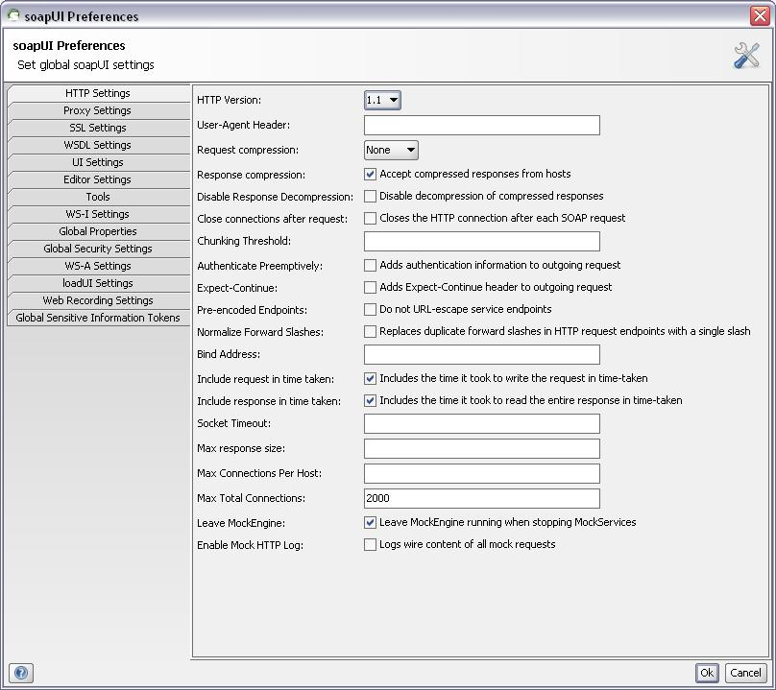
Before Creating a Project
Need to set Global Soap UI Preferences
SOAP UI is a highly configurable tool. One central place for configuring the behavior of soap UI is the preferences dialog. You can open this by selecting the "Preferences" option from the file menu.

Slide 30
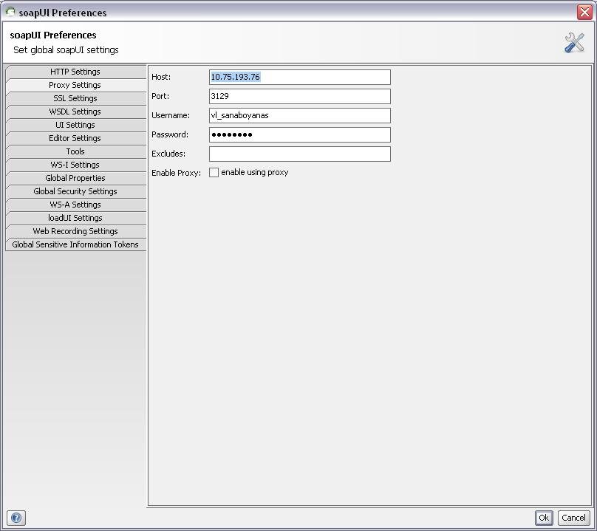
Proxy Settings
SOAP UI tools provides the option to configure proxy settings which are specific to the
Web service:
Host
Port
Username
Password
Excludes
Enable Proxy: check box to enable and disable the configured proxy settings

Slide 31
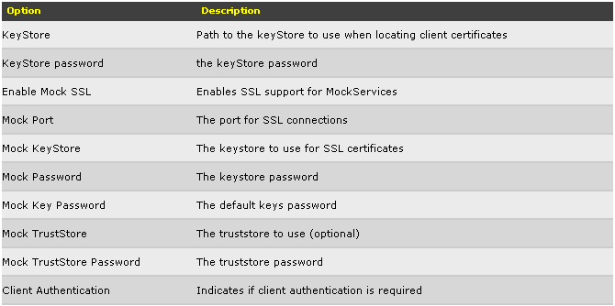
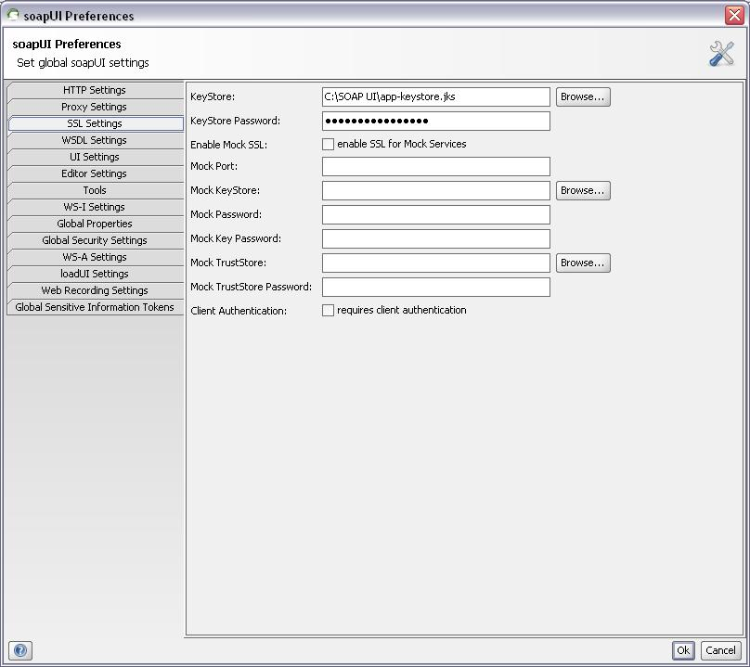
SSL Settings
Like Proxy setting we can configure the SSL setting in the toll if the web service is built with security certificates
Key Store – This is required for establishing the connections to the server.
Key Store password – Key store credentials

Slide 32
SOAP UI Overview

Slide 33
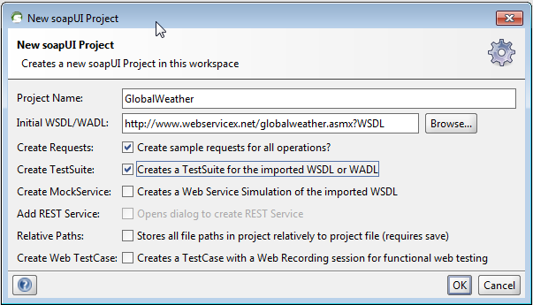
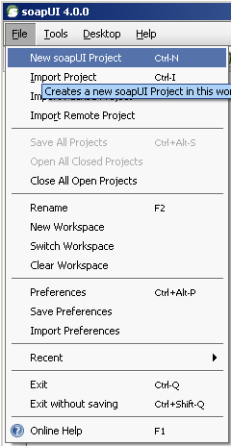
Creating Project and Test Suite
Creating New Project
For creating a new project right click on workspace (Demo) icon, select create project. In the new window give a project and location of WSDL. While creating a project you can check the Default options provided in New Soap UI Project window

Slide 34
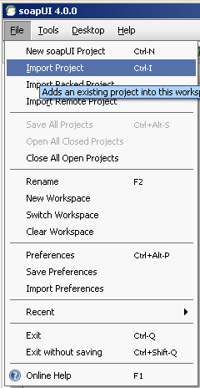
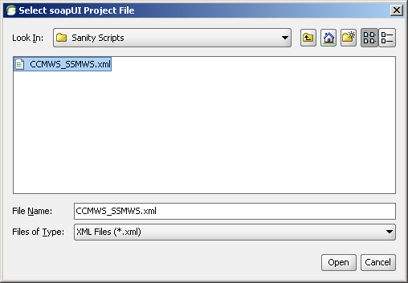
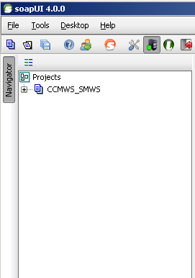
Import Existing Project
Importing a Project
Import Project: If a project already exists then the project can be imported by selecting import project option and giving the appropriate path.
Import Packed Project: A compressed or zipped project can be imported by selecting the import packed project option.
A Soap UI project is now created with all the operations. Expand the operations to view sample requests

Slide 35
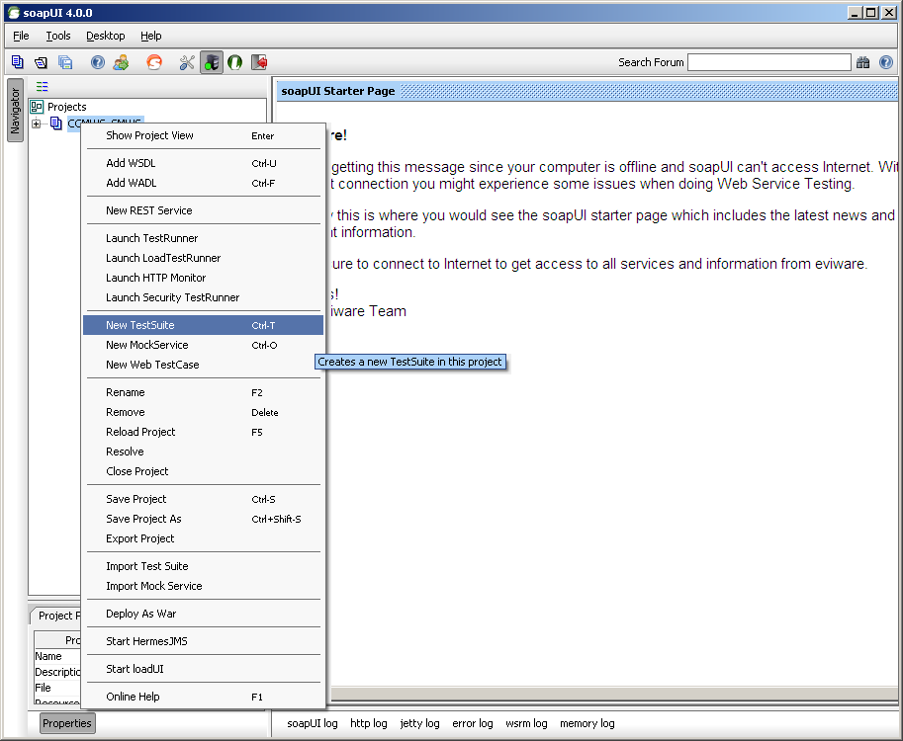
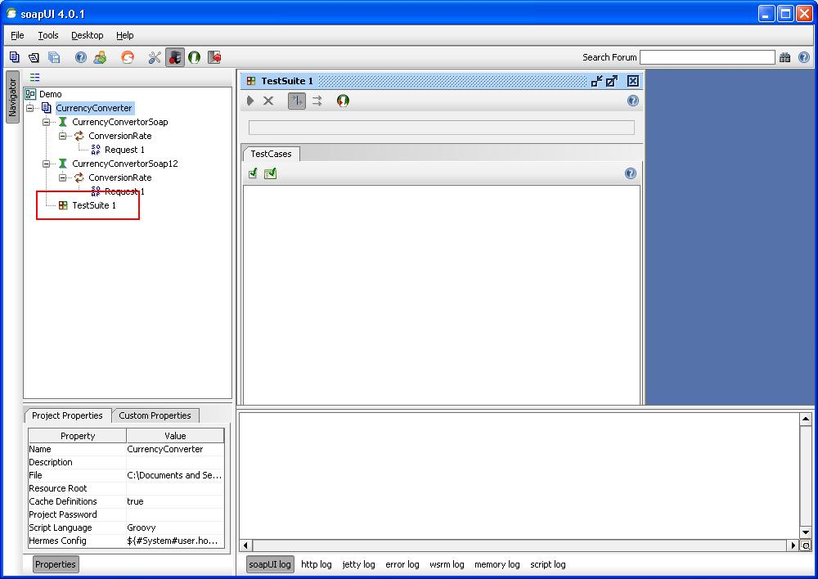
Test Suite
Test suite refers for the set of test cases and can be considered as a module where all the group level test cases are covered.
It also provides an option to execute all the cases with one click by invoking test runner at test suite.
For creating a new test suite right click on Project “CurrencyConverter”, Select New TestSuite from the menu. Give a specific name to the test suite and click on OK. A new test suite with the specified name will be created. A project can have one or more than one test suite.

Slide 36
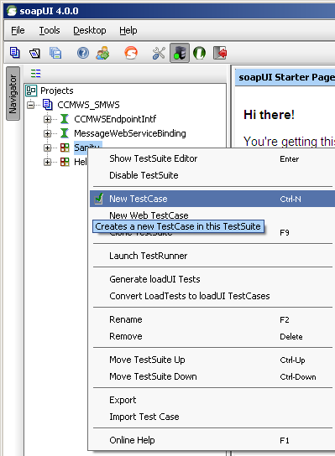
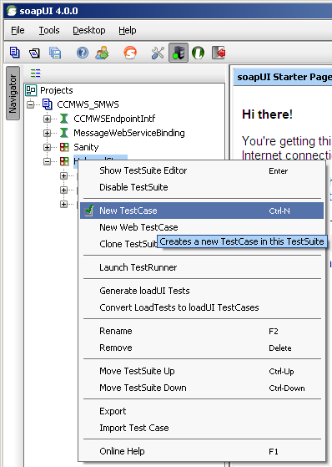
Test Cases
Test case consists of multiple steps based on the scenario. Test runner can be invoked at test case level which will execute all the test steps available in the test case.
For creating a test case under a test suite, right click on Test Suite icon and select New Test case form the menu. Give the specific name and click on OK. A new test case with specified name will be created. Expand the Test Suite icon to view the newly added test case.

Slide 37
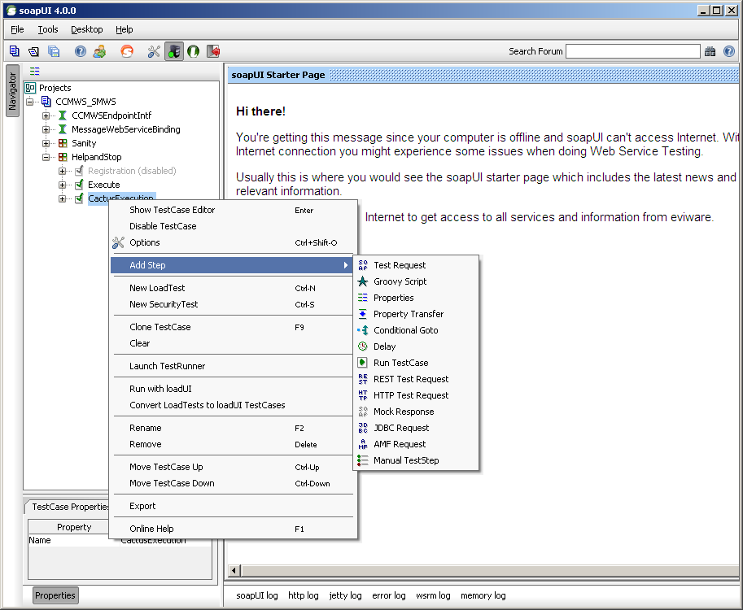
Test Steps
Below are different types of test steps that can be defined in our test case
Test Request
Groovy Script
Properties
Property Transfer
Delay
REST Test Request
HTTP Test Request
Mock Response
JDBC Request
AMF Request
Manual Test Step
Test Step is the building block of test case.
we will add multiple test steps in one test case based on the scenario. Soap UI gives you the option for creating the new test step or clones the existing test steps from other test cases.
Image denotes about adding test step by clicking the mouse right button at test case.

Slide 38
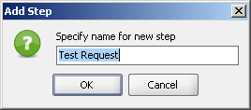
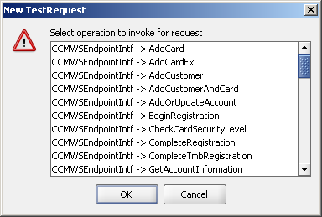
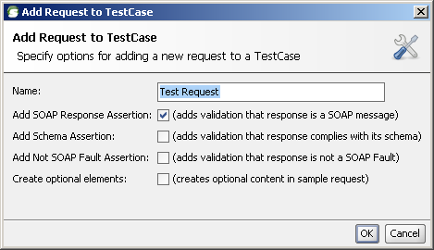
Test Request
For creating SOAP Request right click test step-> select add step and test type Test Request. Give a specific name to test step and select the operation type

Slide 39
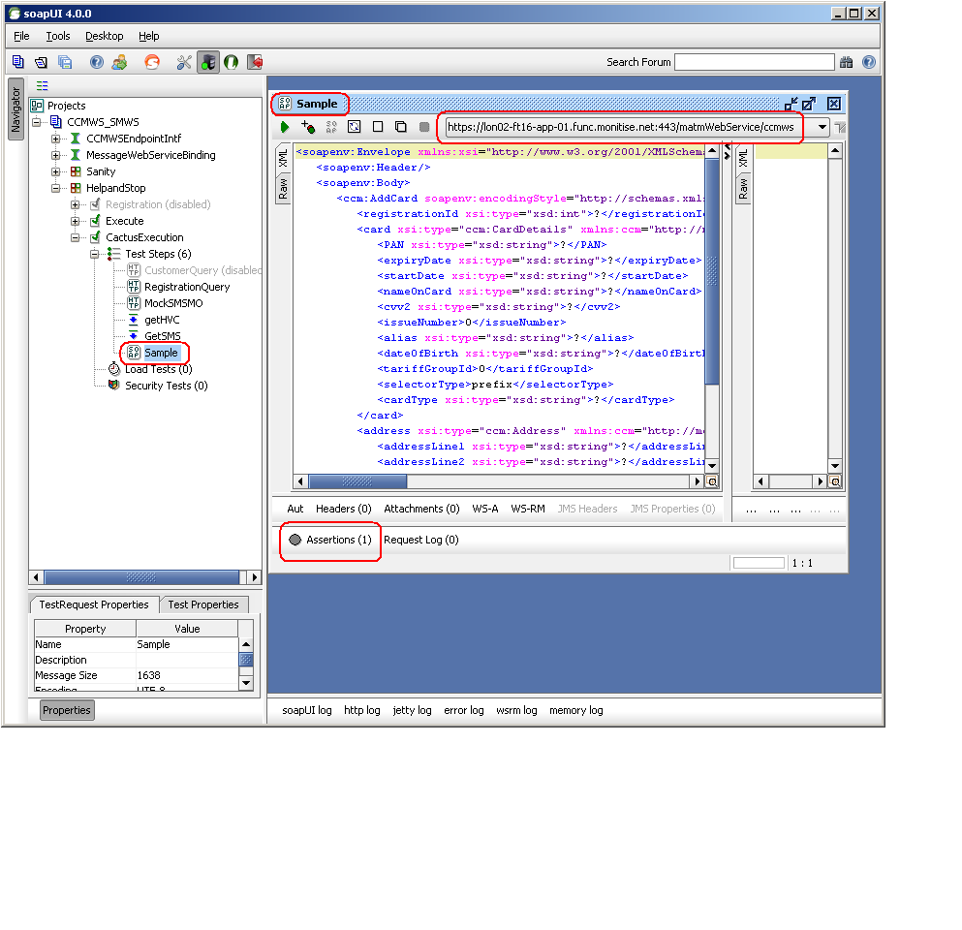
Request Editor

Slide 40

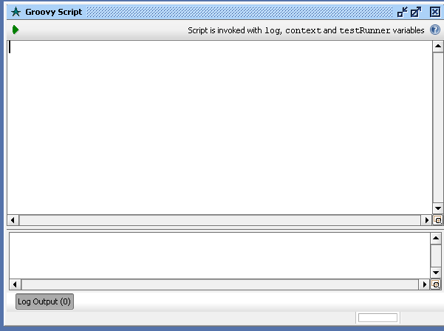
Groovy Script Step

Slide 41
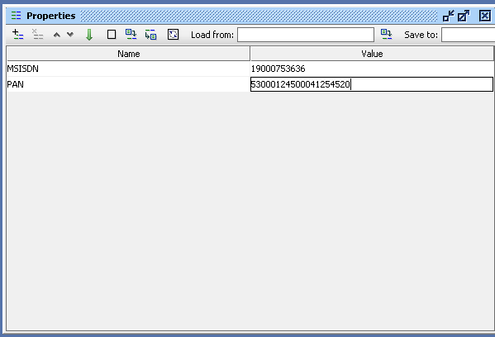
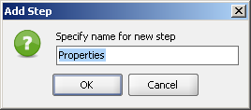
Properties
This feature allows you to define an arbitrary number of properties that can optionally be read from or written to a file. These can be used for parameterization of requests, assertions, etc.
Property step can be created by selecting property test step. We can add one or more properties by selecting add properties icon. We can give a default value for the added property or can be parameterized.

Slide 42
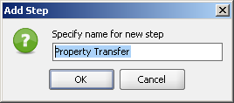
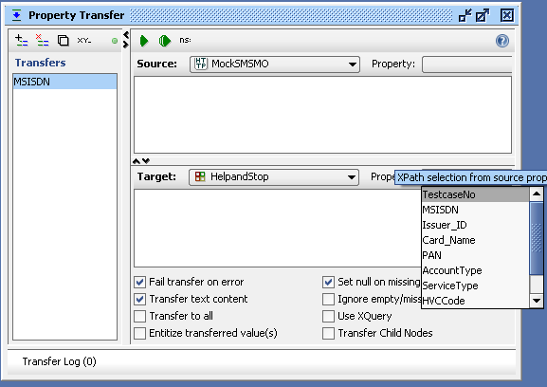
Property Transfer
Allows you to transfer or extract property values between TestSteps,
For example you can extract a value from a response message and write it to another TestStep for external storage.

Slide 43
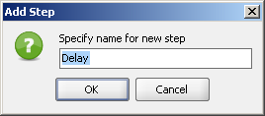
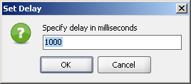
Delay
Pauses the execution of the TestCase for the configured number of milliseconds

Slide 44
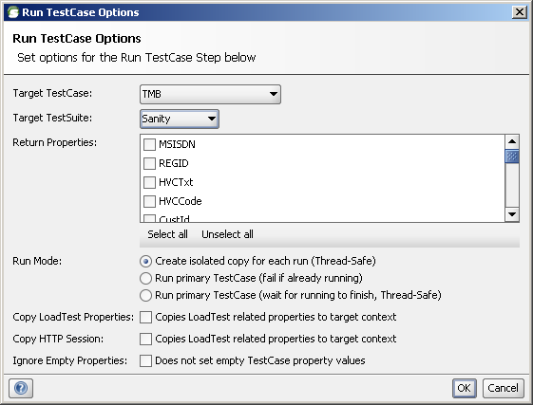
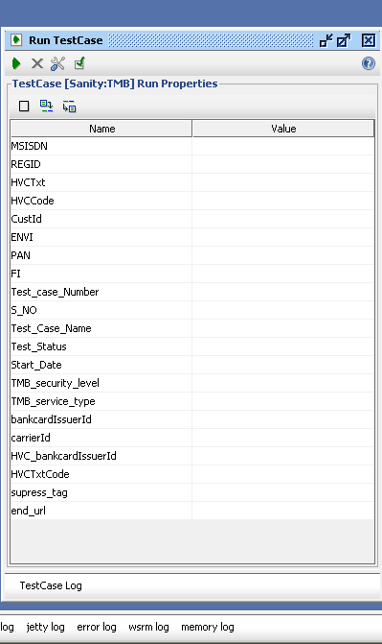
Run Test Case

Slide 45
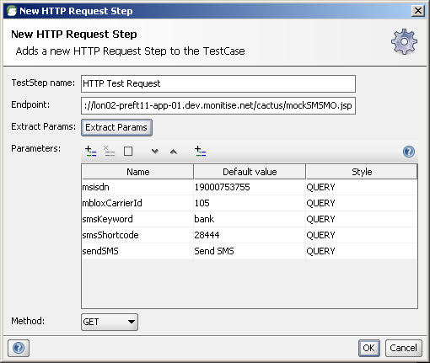
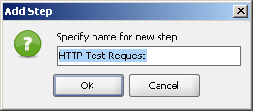
HTTP Test Request

Slide 46
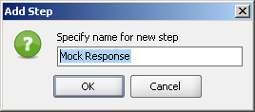
Mock Response
SOAP UI tool also providing the option to host the mock server
We can configure the project specific customized responses in it
Mock response will act as dummy response which will be useful when server is not ready
Like other test steps we can add mock response in the form of test step

Slide 47

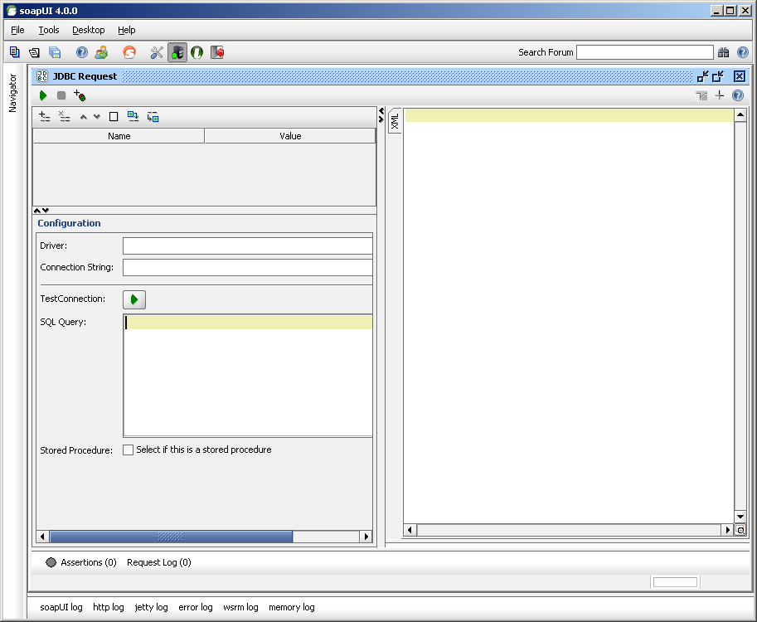
JDBC Request
JDBC request is used to run database queries directly from SoapUI. The Query results can be viewed in XML format in the response window. JDBC connection can be setup at project level as well as at test step level.

Slide 48

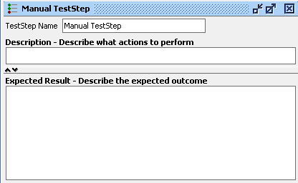
Manual TestStep

Slide 50
Web Services Testing
Day 3

Slide 51
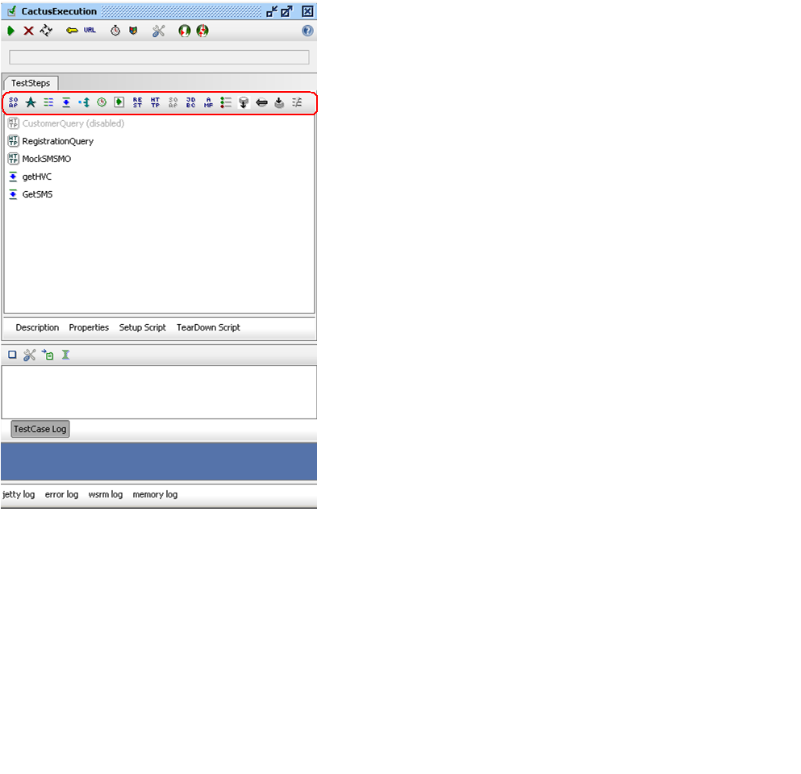
Test Case Editor

Slide 52
Assertions
Assertions are used to validate the message received by a Test Step during execution.
Any number of assertions can be added to a Test Step.
After a Test Step executes, all its assertions are applied to the received response and if any of them fail the Test Step is marked as failed in the Test Case view.

Slide 53
Types of Assertions
Contains - Searches for the existence of a string token in the property value, supports regular expressions. Applicable for any property.
Message Content Assertion - Allows for complex content validation of XML messages. Applicable to any property containing XML.
Not Contains - Searches for the non-existence of a string token in the property value, supports regular expressions. Applicable to any property.
XPath Match - uses XPath expression to select content from the target property and compares the result to an expected value. Applicable to any property containing XML
XQuery Match - uses a XQuery expression to select content from the target property and compares the result to an expected value. Applicable to any property containing XML

Slide 54
Types of Assertions
Script Assertion - runs a custom script to perform arbitrary validations. Applicable to TestSteps only (i.e. not properties)
Response SLA - validates that the last received response time was within the defined limit. Applicable to Script TestSteps and TestSteps that send requests and receive responses.
JMS Status - validates that the JMS request of the target TestStep executed successfully. Applicable to Request TestSteps with a JMS endpoint.
JMS Timeout - validates that the JMS statement of the target TestStep did not take longer than the specified duration. Applicable to Request TestSteps with a JMS endpoint.
Sensitive Information Exposure - Checks that the last received message does not expose any sensitive information about the target system. Applicable to REST, SOAP and HTTP TestSteps.

Slide 55
Test Step Specific Assertions
For SOAP Request TestSteps the following assertions are available
Schema Compliance - validates the response message against the definition in the WSDL and contained XML Schema
SOAP Response - checks that the response is a valid SOAP Response
SOAP Fault - checks that the response is a SOAP Fault
Not SOAP Fault - checks that the response is not a SOAP Fault
WS-Security Status - validates the WS-Security headers and tokens in the response
WS-Addressing Response - validates the WS-Addressing Headers in the response
JMS Timeout - when using a JMS endpoint that specifies a response channel this assertion validates that the response is received within the specified time
JMS Status - when using a JMS endpoint, this assertion validates that no JMS-related errors occurred

Slide 56
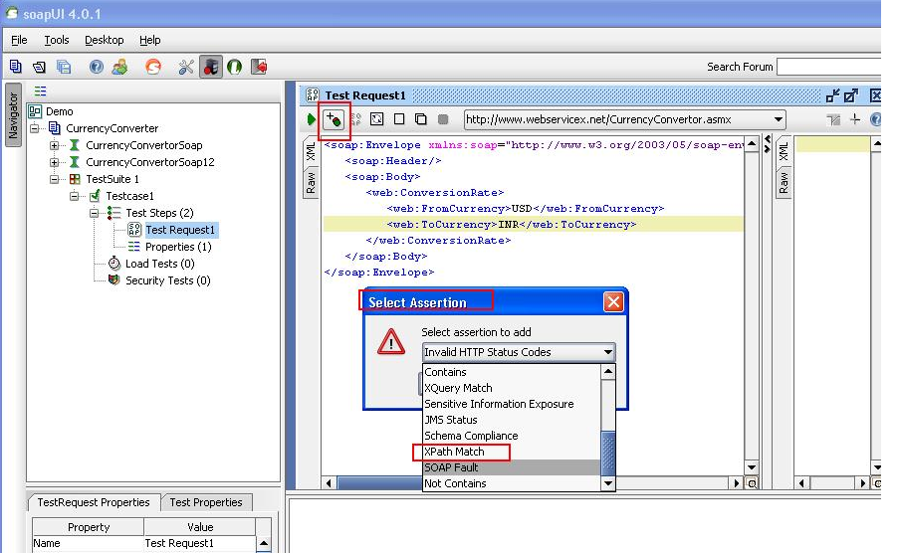
Add assertion to Test Step
Following is the example for adding xpath assertion in test step
Open a test step click on add assertion icon. Select the assertion type from drop down and give a unique name to assertion.

Slide 57
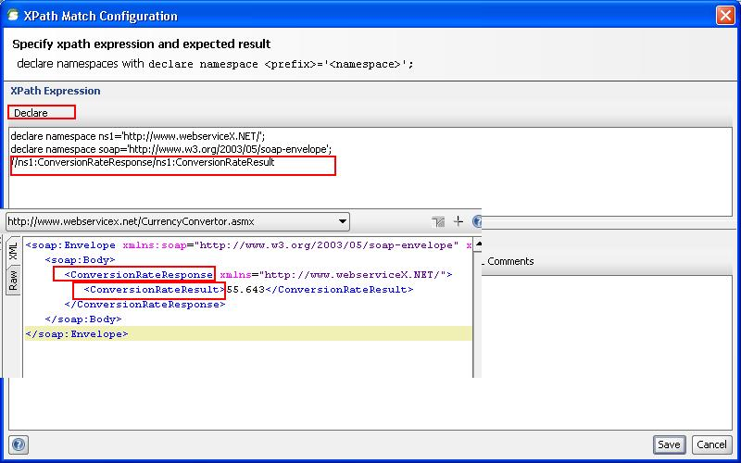
Xpath Match
Declare the xpath with exact node value of the response parameter for which validation needs to be done

Slide 58
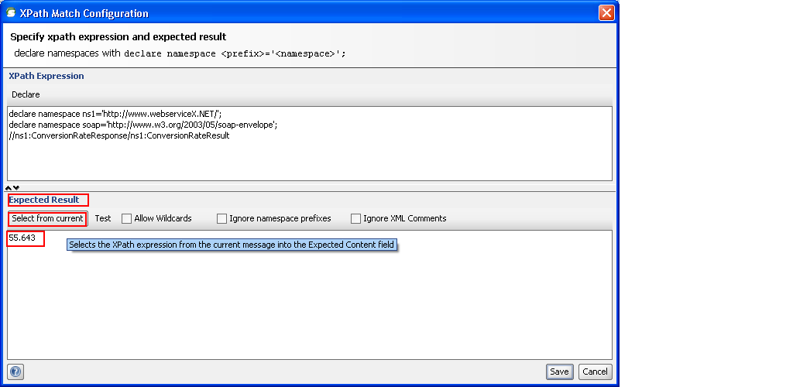
Xpath Match
In the expected section we can define the expected value or extract the current value for the defined xpath and click on OK. XPath assertion will be created

Slide 59
Working with Properties
Properties can be used to hold the endpoints of your services, making it easy to change the actual endpoints used during test execution
Properties can be used to hold authentication credentials, making it easy to manage these in a central place or external file
Properties can be used to transfer and share session ids during test execution, so multiple teststeps or testcases can share the same sessions
Custom properties can be defined at Preferences(Global), Project, TestSuite, TestCase and TestStep level and also in properties test Step.

Slide 60
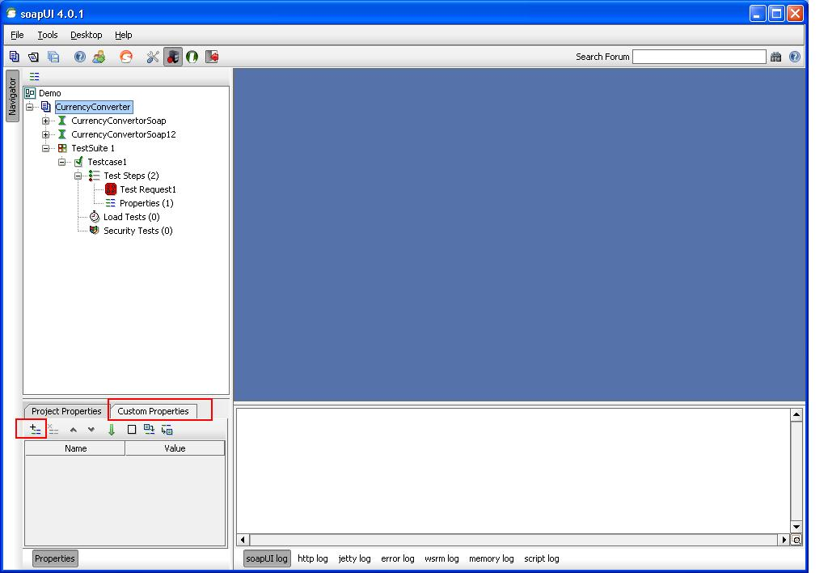
Project Level
Defining properties at these levels allows them to easily be accessed across project.
For example, property stored at the testsuite level can be accessed inside a request message with a standard property expansion; ${#TestSuite#From}. Similarly property at project level and testcase level can be accessed as ${#Project#From}, ${#Testcase#From} respectively.

Slide 61
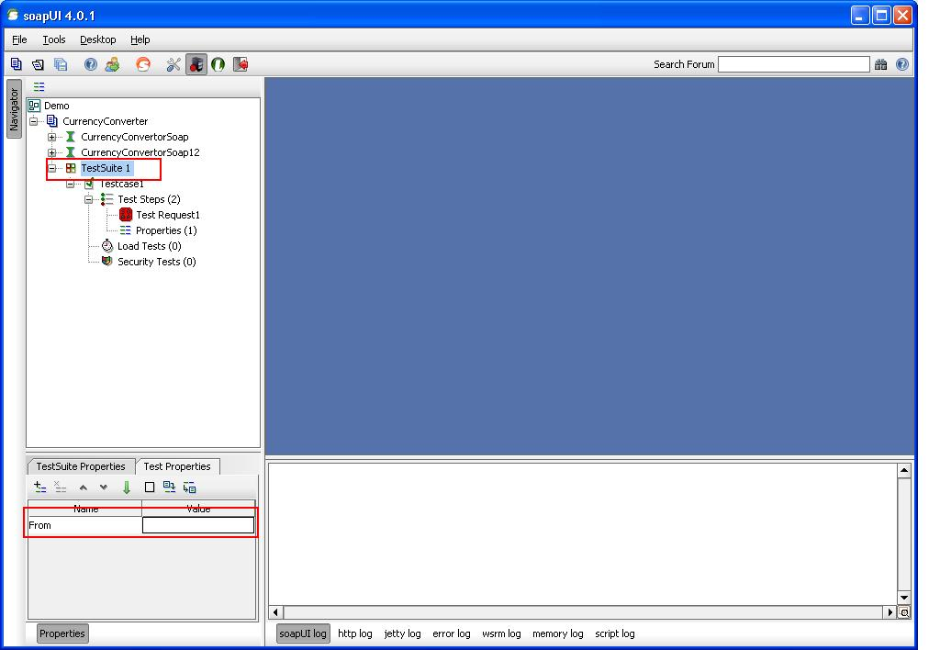
Test Suite Level

Slide 62
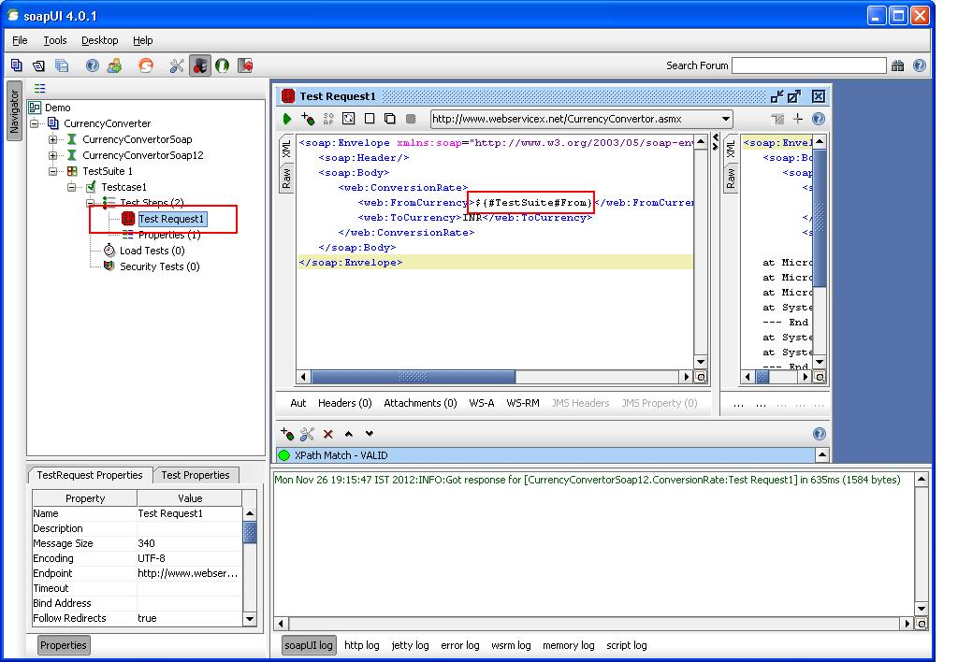
Test Step Level

Slide 63
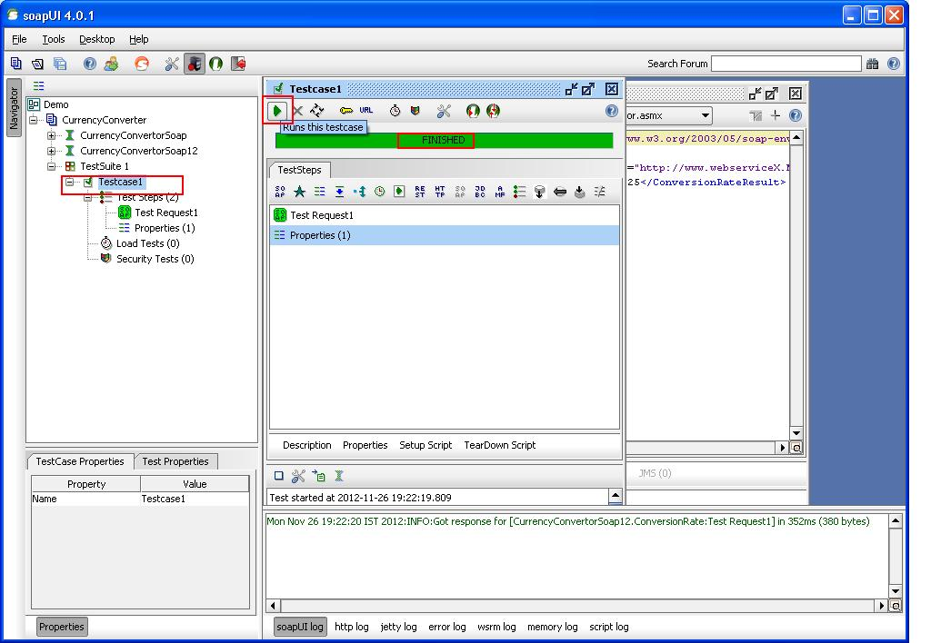
Execution
Executing Test case and Test Step:
To execute a test step double click the test step. Test Step editor will open, click on the run button. Test Step will run.
To execute a test Step, double click the test case. Test case editor will open, click on the run button. All the test steps in attest case will run in serial order.

Slide 64
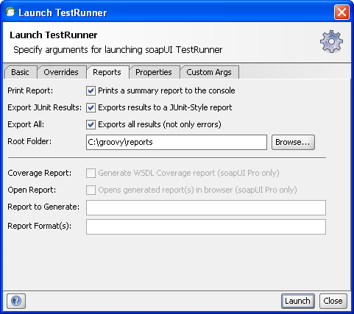
Reporting
By default test runner provides the option for generating the reports in the configured path,
Here are the reports configurations in the test runner popup
Now if we run the TestRunner we get the results stored at the location specified.

Slide 66
Web Services Testing
Day 4

Slide 67
Agenda
Groovy
Groovy in SoapUI
The SoapUI Object Model
Getters and Setters – 1
Getters and Setters – 2
Groovy Programming Concepts

Slide 68
Groovy
“Groovy is an agile dynamic language for the Java Platform with many features that are inspired by languages like Python, Ruby and Smalltalk, making them available to developers using a Java-like syntax.”

Slide 69

My Class is your Class
ggg
JAVA
Groovy
Java Runtime Environment

Slide 70
Groovy in SOAPUI
SetUP script
Tear Down Script
Groovy Test Request Step
Data Source Test Step
Data Sink Test Step
Data Gen Test Step
Script Assertions
Mock Response Scripts

Slide 71
SOAP UI Object Model
In soapUI all project-related artifacts e.g. Projects, Requests, TestSuites, etc are ModelItems.
A modelItems' name, description etc. can all be accessed through the corresponding getters.
The general model for accessing children of a certain type to a ModelItem is as follows (XX = the type of child):
getXXCount()
getXXByName( String name )
getXXAt( int index )
getXXList()
Setting/getting properties
// set property value object.setPropertyValue( "name", "value" ) object.properties["name"].value = "value" // get property value log.info object.getPropertValue( "name" ) log.info object.properties["name"].value log.info object.properties."name".value

Slide 72
Getters & Setters
// get properties from testCase, testSuite and project
def testCaseProperty = testRunner.testCase.getPropertyValue( "Prop1" )
def testSuiteProperty = testRunner.testCase.testSuite.getPropertyValue( " Prop2" )
def projectProperty = testRunner.testCase.testSuite.project.getPropertyValue( " Prop3" )
def globalProperty = com.eviware.soapui.SoapUI.globalProperties.getPropertyValue("MyProp")
// setting values in testCase, testSuite and project
testRunner.testCase.setPropertyValue( " Prop4","xyz")
testRunner.testCase.testSuite.setPropertyValue( " Prop5","abc")
testRunner.testCase.testSuite.project.setPropertyValue( " Prop6","123")
com.eviware.soapui.SoapUI.globalProperties.setPropertyValue( " Prop7","userName")

Slide 73
Getters & Setters (Contd.)
//setting property in test case through test case set up script
testCase.setPropertyValue("PropName", "PropValue")
//setting property in test step through test case set up script
testCase.getTestStepByName("TestStepName").setPropertyValue("PropName", "PropValue")
//setting property in test suite through test suite set up script
testSuite.setPropertyValue("PropName", "PropValue")
//setting property in test suite through test suite set up script
testSuite.getTestCaseByName("TestCaseName").getTestStepByName("TestStepName").setPropertyValue("PropName", "PropValue")

Slide 74
Getters & Setters (Contd.)
def project = testRunner.testCase.testSuite.project def project = context.testCase.testSuite.project
def myTestSuite = project.getTestSuiteAt(IndexNumber) def myTestSuite = project.getTestSuiteByName(“Name of the TestSuite”)
def myTestCase = myTestSuite.getTestCaseAt(IndexNumber) def myTestCase = myTestSuite.getTestCaseByName(“Name of the TestCase”)
def myTestStep = myTestCase.getTestStepAt(IndexNumber) def myTestStep = myTestCase.getTestStepByName(“Name of the TestStep”)

Slide 75
Context Variable vs testRunner variables
testRunner - a TestCaseRunner object (javadoc), which is the entry-point to the SoapUI API for accessing project items, results, etc.
The TestRunner is the object that is actually executing the TestCase by cycling through the TestSteps in the TestCase and executing them.
It exposes methods related to test execution and the underlying object model (via the testCase property).
TestRunner object is usually used to control the test run (start, stop, etc). And to get the information on test suite, project, steps, etc. Context is typically used as a session placeholder for variables you want to instantiate and later refer to.

Slide 76
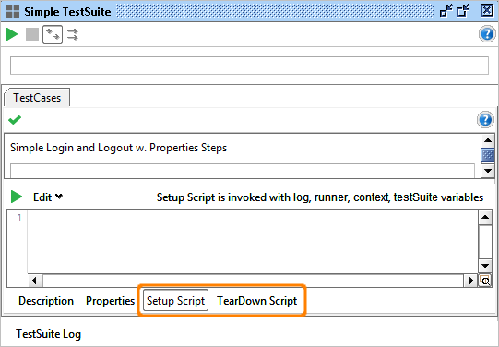
Setup and TearDown Scripts
Setup and TearDown scripts are available at all three testing levels in SoapUI; Project, TestSuite and TestCase.
In all cases they are managed via dedicated tabs at the bottom of the corresponding Test tab/window, for example in the TestSuite window;

Slide 77
String Methods
Some common methods on Strings
indexOf() e.g. 'GroovySession'.indexOf('i')
lastIndexOf() e.g. 'GroovySession'. lastIndexOf('o')
substring() e.g. 'GroovySession'. substring(6)
contains() e.g. 'GroovySession'. contains("ssi")
replace() e.g.'GroovySession'. replace("Groovy","SoapUi")
toLowerCase() e.g. 'GroovySession'. toLowerCase()
toUpperCase() e.g. 'GroovySession'. toUpperCase()
equalsIgnoreCase() e.g. 'GroovySession'. equalsIgnoreCase("grooVysession")
contentEquals() e.g. 'GroovySession'. contentEquals("GroovySession")
startsWith() e.g. 'GroovySession'. startsWith("Groovy")
endsWith() e.g. 'GroovySession'. endsWith("Session")
' + ' and ' - ' operators can be used on strings

Slide 78
Classes and Objects
Class - A class is simply a representation of a type of object. It is the blueprint/ plan/ template that describe the details of an object and from which the individual objects are created.
Object - An object is an instance of a class that can perform a set of related activities. Each different type of object comes from a specific class of that type.
A Sample Program:
class Test // create class Test
{
int a
int b
int sum
def add(a,b)
{
sum = a + b
}
}
def oTest = new Test() // create object
log.info oTest .add(2,5) // output sum

Slide 79
Control Statements
Important Control statements
Conditional Statements
if (condition) { switch(condition) {
set of statements… {
} else case A : set of statements
{ case B : set of statements
set of statements case ….
} }
Iterative statements
for (iCtr in 0..10)
{
}
for(i = 0; i < n; i++)
{
}

Slide 80
Collections, Arrays & Maps
Lists - ordered collection of objects.
e.g. def list = [1, 8, 7, 4]
e.g. def list = []
Common methods – getAt(), putAt(), add(),max(),min(),remove(),contains(),containsAll(),size()
Ranges - consecutive lists of sequential values .
e.g. 5..10 ; a..g
Object Array - fixed-size sequence of objects.
e.g. def oArray= new Object[4]
Maps - mapping from unique unordered keys to values
e.g. map = [1:'a', 2:'b', 1:'c' ]

Slide 81
Data Driven Testing
Data-driven testing is when test data (input, expected output, etc) is stored in some external storage (database, spreadsheet, xml-files, excel sheet etc) and then this data is used iteratively in tests while running.
Or, in other words
Nodes in XML are being tested across various set of data which is passed from external sources to nodes through parametrization.

Slide 83
Thank You!!!

